Slide 1


From Traditional to Modern
Vanguard's UI Evolution
Amir Marco

Slide 2

Vanguard, a prominent U.S.-based investment management company, embarked on a journey to evolve digital experience with the goal of enhancing client engagement.
Recognizing the rapidly changing digital landscape, we aimed to refine our online process with a sleeker, more intuitive User Interface (UI). This strategic move was driven by our commitment to meeting the growing needs of our clients and ensuring a more seamless navigation experience across our digital platform.
Did the new UI lead to higher
completion rates?

Slide 3

01
03
Datasets
Client Profiles Client Data such as total accounts, balance, tenurity, call and login details
Cleaning & Merging
Corrected Data Types
Removed Duplicate Rows
Handled Missing Values
Filtered Outliers
Split Data such as date & time
Created New Features like age groups
Digital Footprints Consist of digital IDs, process steps, date and time of online activity
02
Experiment Roster Client details from Test and Control group
Merged dataset into one big data set

Slide 4

01 UI experiment
User Interface
START
STEP_1
STEP_2
STEP_3
CONFIRM
Successful test > reaching the Confirm step
Fail test > not reaching the Confirm step

Slide 5
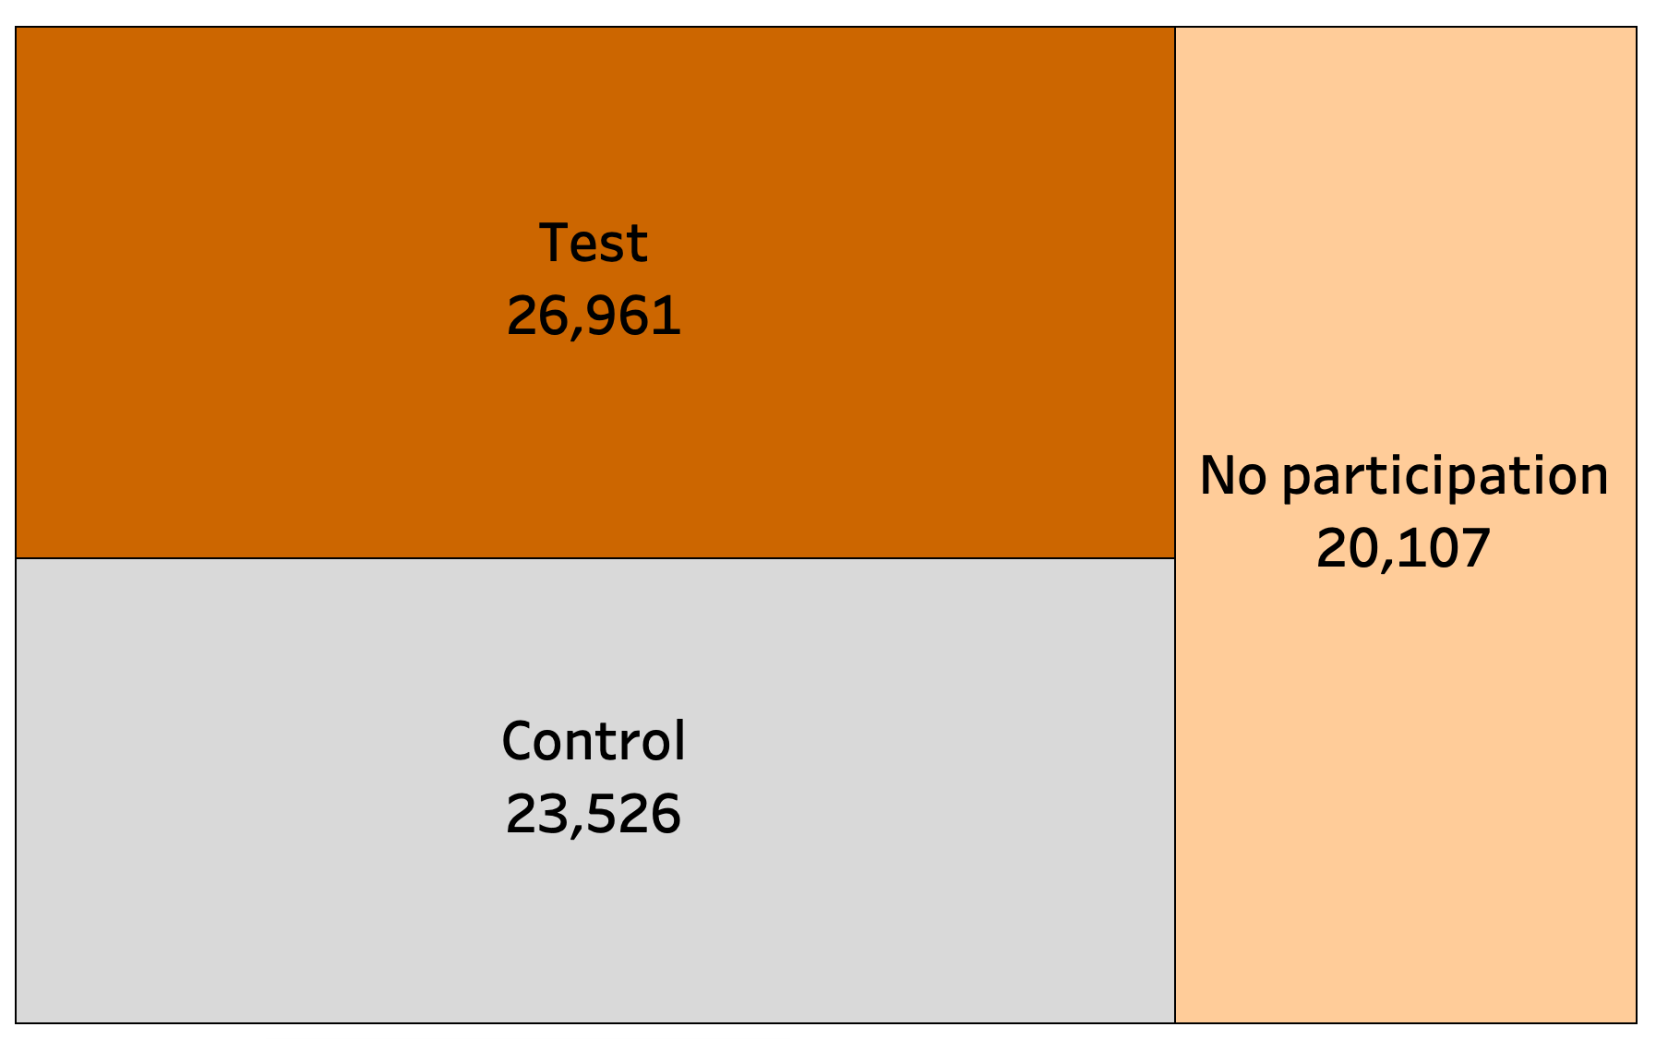
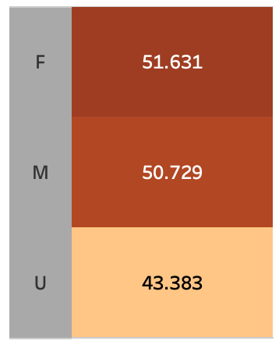

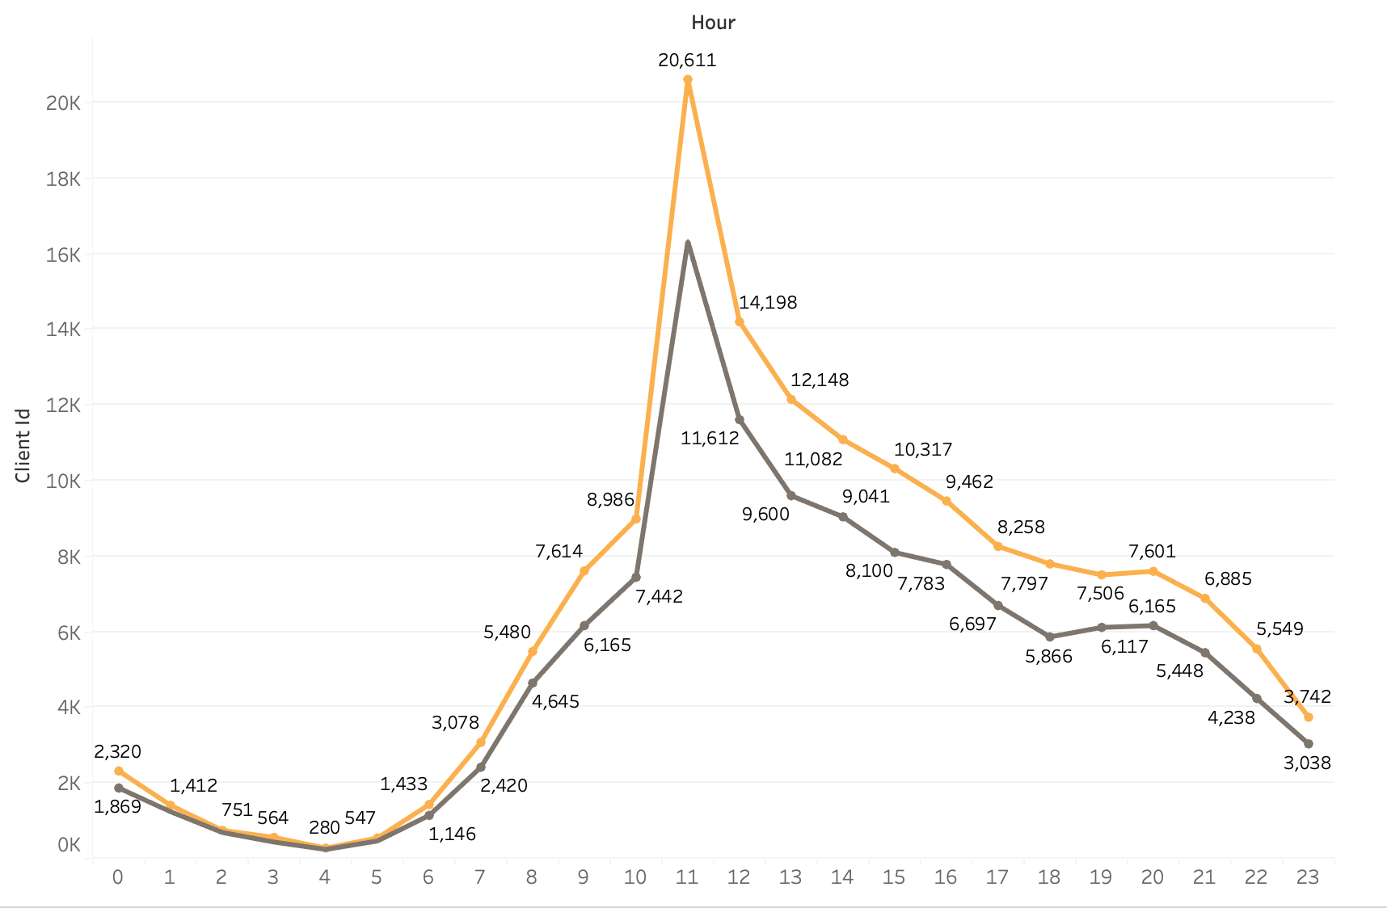
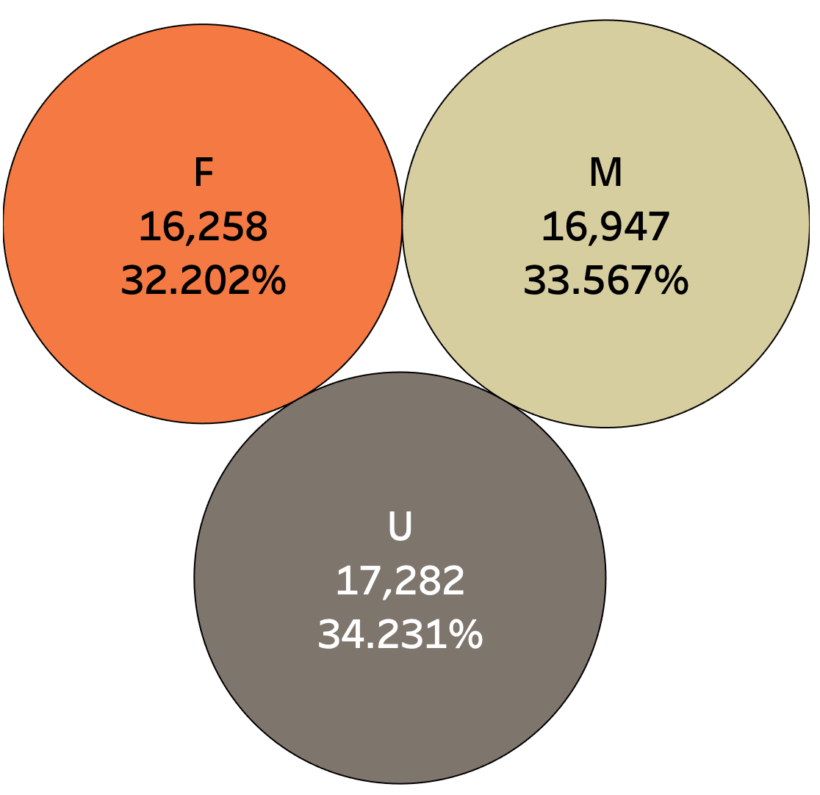
02 Client Details
Client Participation
Average Age
Client Gender
Login Counts
Mars

Slide 6

03 Experiment
Introduction
Control
Test
Control > Group of participants working on the old UI
Test > Group of participants working on the new UI

Slide 7
Group
Comparability
⅓ Female ⅓ Male | 17 - 96 | 47 | 12 years | 150,152
Gender | Age range | Average age | Average tenure | Average balance
⅓ Female ⅓ Male | 17 - 96 | 47 | 12 years | 148,963
Control
Test

Slide 8
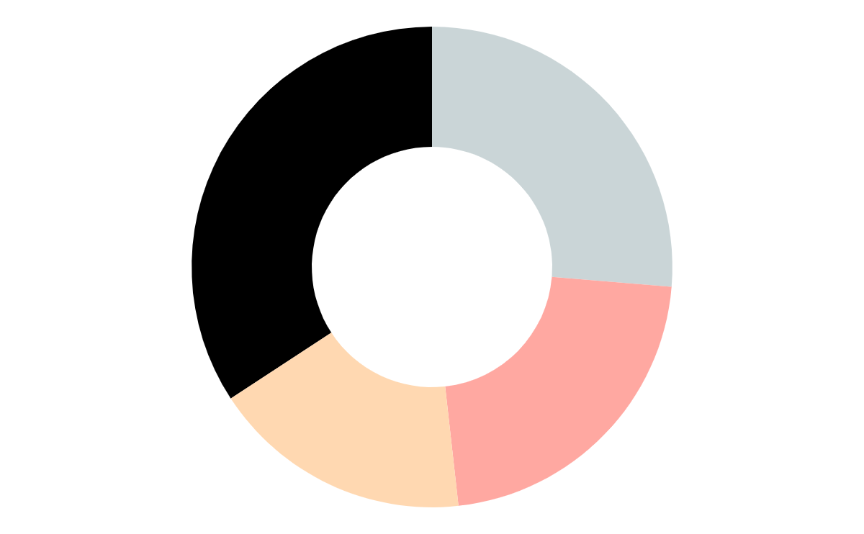
04 Hypothesis
1: Younger clients have a higher completion rate
2: Clients with more accounts have a higher completion rate
3: The control group has a higher completion rate

Slide 9

05
A/B Test

Slide 10

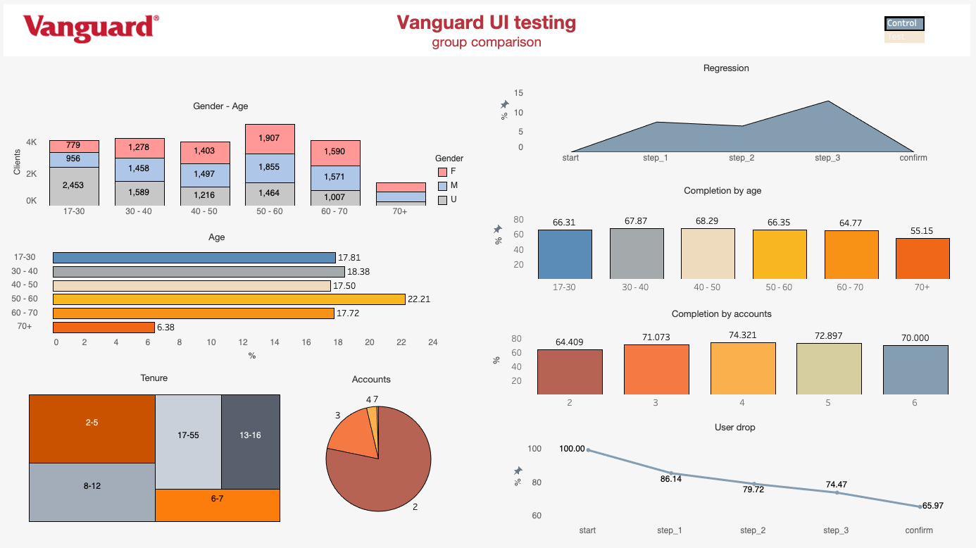
05 Visual AB analysis
Link

Slide 11
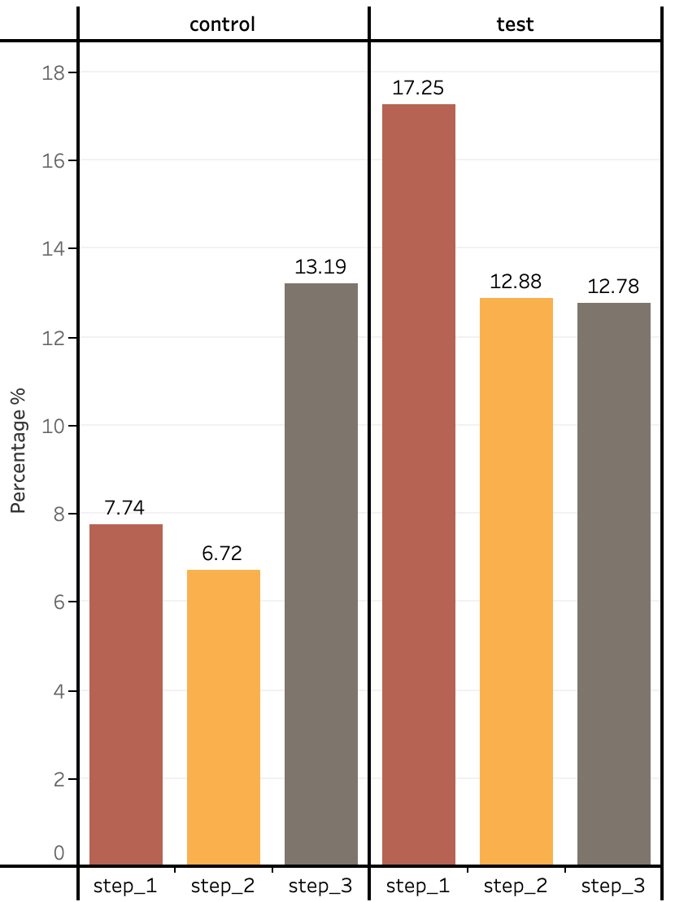
05 Conclusion
Regression
Control group has high regression at step 3 which suggests complexities or unclear instructions at this stage, indicating a need for simplification or enhanced guidance.
Test group's regression at step 1 highlights initial confusion with the new UI, suggesting the initial elements may require clearer communication or user orientation.
These insights emphasize the critical areas for UI enhancement to bolster user confidence and streamline the navigation process, thereby improving overall completion rates.

Slide 12
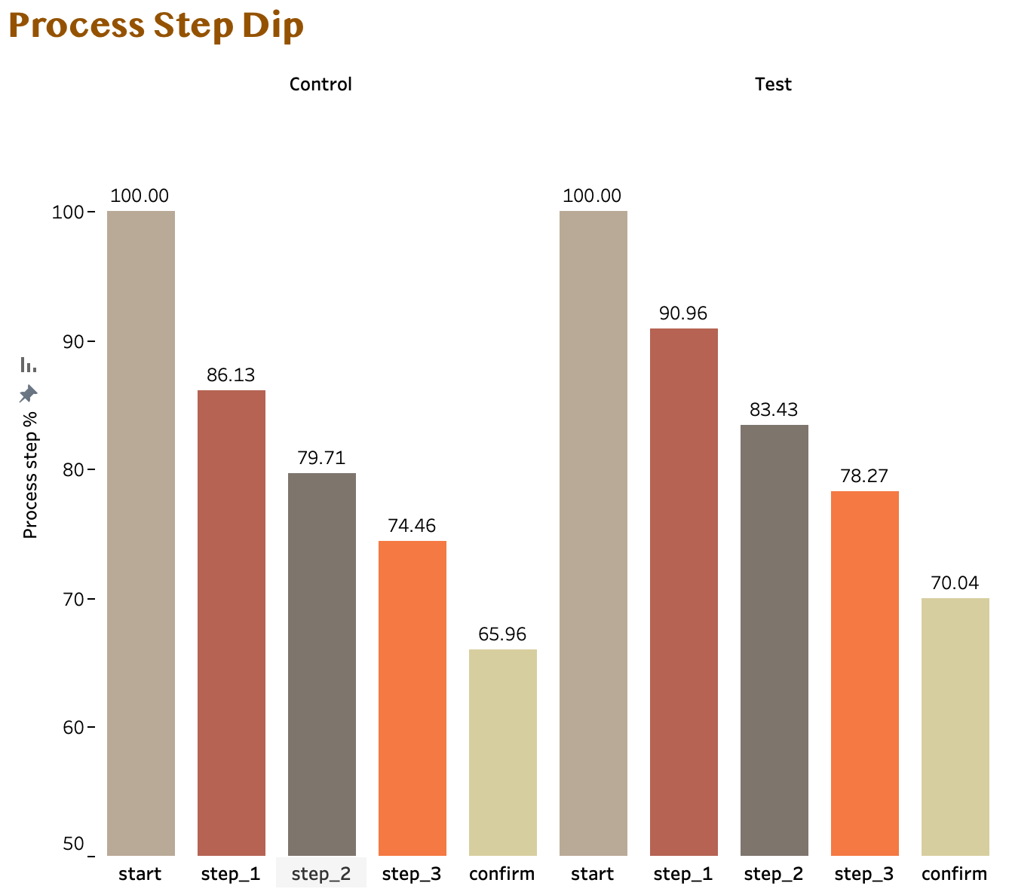

Total Completion
6.20%*
The 6.20% improvement in the completion rate for the Test group, with the new UI design, significantly exceeds Vanguard's minimum threshold of 5%.
This indicates that the redesign is not only cost- effective, per Vanguard's criteria, but also beneficial for enhancing user engagement and potentially increasing revenue.
*6.20% improvement is calculated based on the relative improvement percentage formula, which measures how much the Test group's rate has increased in proportion to the Control group rate.

Slide 13
06 Recommendations
Committed
Regressed
The participants between 50-60 years old are largest participating group. The participants in age above 70 and in age 40-50 had lowest participation.
Participants in Test group regressed highest in Step-1 whereas control group regressed highest in Step-3
Completion
Tenurity
Age 17-30 has the highest completion rate of 72.75%, whereas people age above 70 has lowest completion rate
Most of the participants are 2-5 years old in the company.

Slide 14


Thank You!
Amir
Marco

